Slide 1

FALL 2023
MIS 381N
Information management
Lecture 3
August 28th 2023
Prashant D. Joshi
UT McCombs School of Business (MSBA), The University of Texas at Austin

Slide 2

Objectives
Data Management Strategy
Review client-server and database concepts
Relational data modeling
Hands-on exercise – break out team
Questions and discussion

Slide 3
What questions may I answer before we begin …
All questions are good questions

Slide 4
Housekeeping
Long lecture today… Will skim over some slides, but including them so you can read them at leisure later
Any feedback on the homework complexity, or the format? This was the first one, but future homework assignments might be a little more involved
Class participation will be in terms of opinions that will be asked of the papers you read. Those opinions need to be uploaded into Canvas and that will be graded for participation. Will work on that in a short while

Slide 5
Review: Application Compute Architectures

Slide 6
Application and Enterprise Software
How does one distinguish between these two types?
Examples of Application Software?
Microsoft Suite, Internet browsers, Communication packages
Examples of Enterprise Software?
Each is a system integrated into a company’s business (Customer Relations, Human Resources, Supply Chain, Asset Management, etc)

Slide 7
Enterprise application software components
VERTICAL
RAS
(Reliability,
Availability,
Serviceability)
Security
Multiple Language Support
Etc.
Presentation Layer
Business Logic Layer
Data Layer

Slide 8
Types of enterprise applications
Finance, Human Resources
Materials Requirement Planning
Enterprise Resource Planning
Supply Chain Management
Customer Relationship Management
Point-of-sale checkout
Automatic Teller Machines
Transaction (Data) Management
Analytics Management
Data warehouse, Data Lake
Reporting
Business Intelligence
Predictive analytics (Data Science)
Hybrid (Transaction/Analytics)
Operations management
Marketing
Budgeting, forecasting
analyzes areas of common activity within or between organizations, where information and other resources are exchanged to guide future states from an integrated viewpoint of strategy, business, and technology
(*) Enterprise Architecture Book of Knowledge. Mitre Corporation.

Slide 9

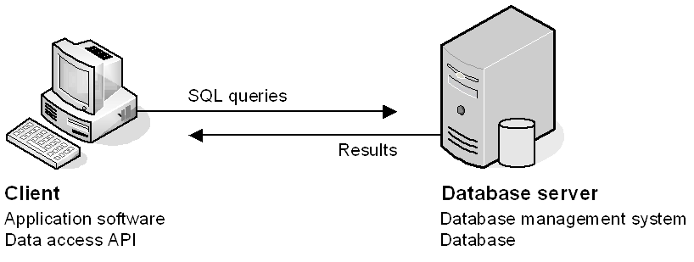
Typical application depiction
Server-side software
Database management system (DBMS)
DBMS does the back-end processing
Client-side software (User App)
Example: SAP
Connects to the DB via a data access API (application programming interface)
The client software does the front-end processing
Typically coding language, API, and database must be compatible (Java, JDBC, Oracle)

Slide 10
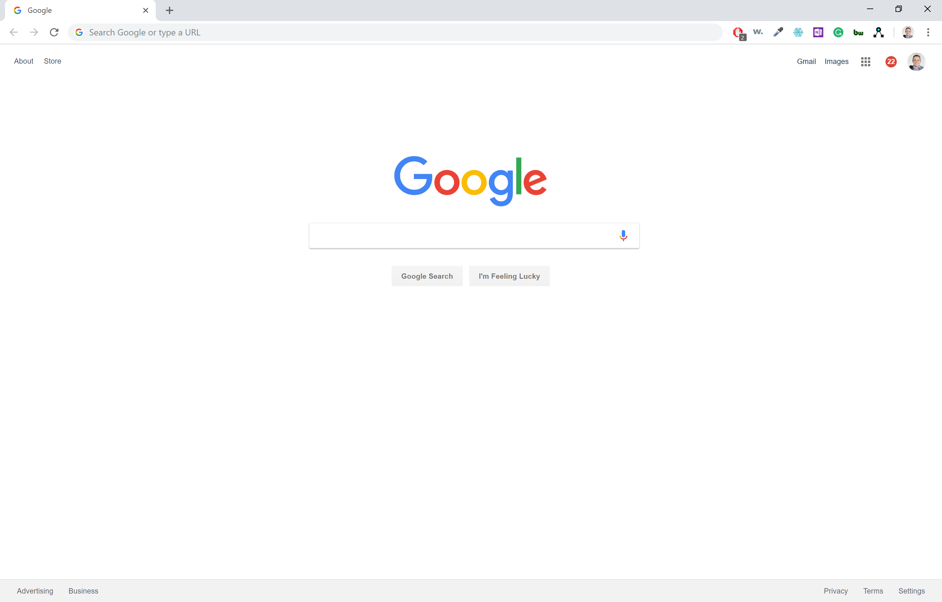
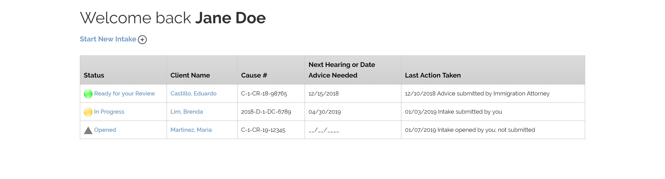
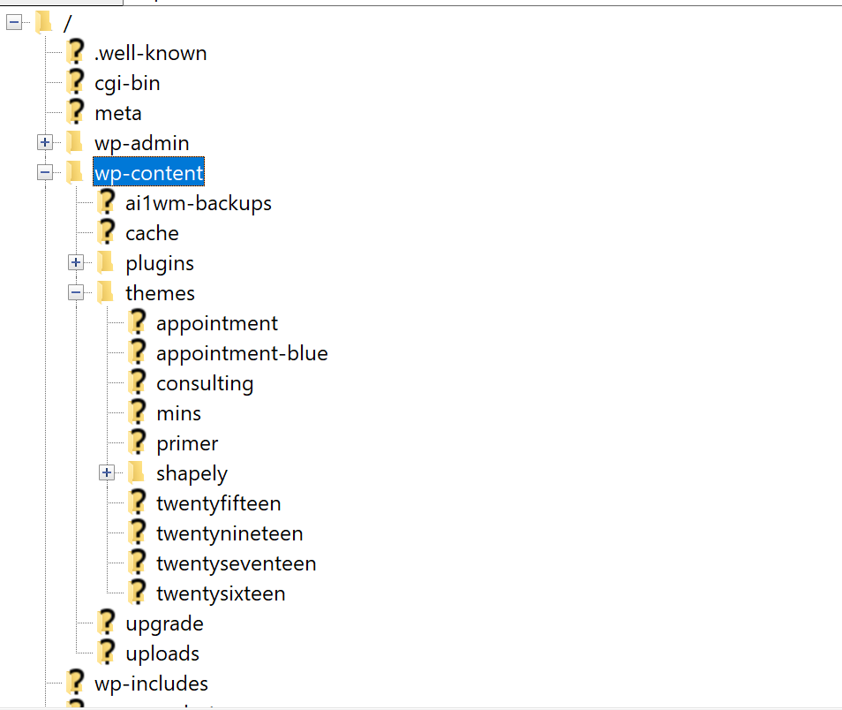
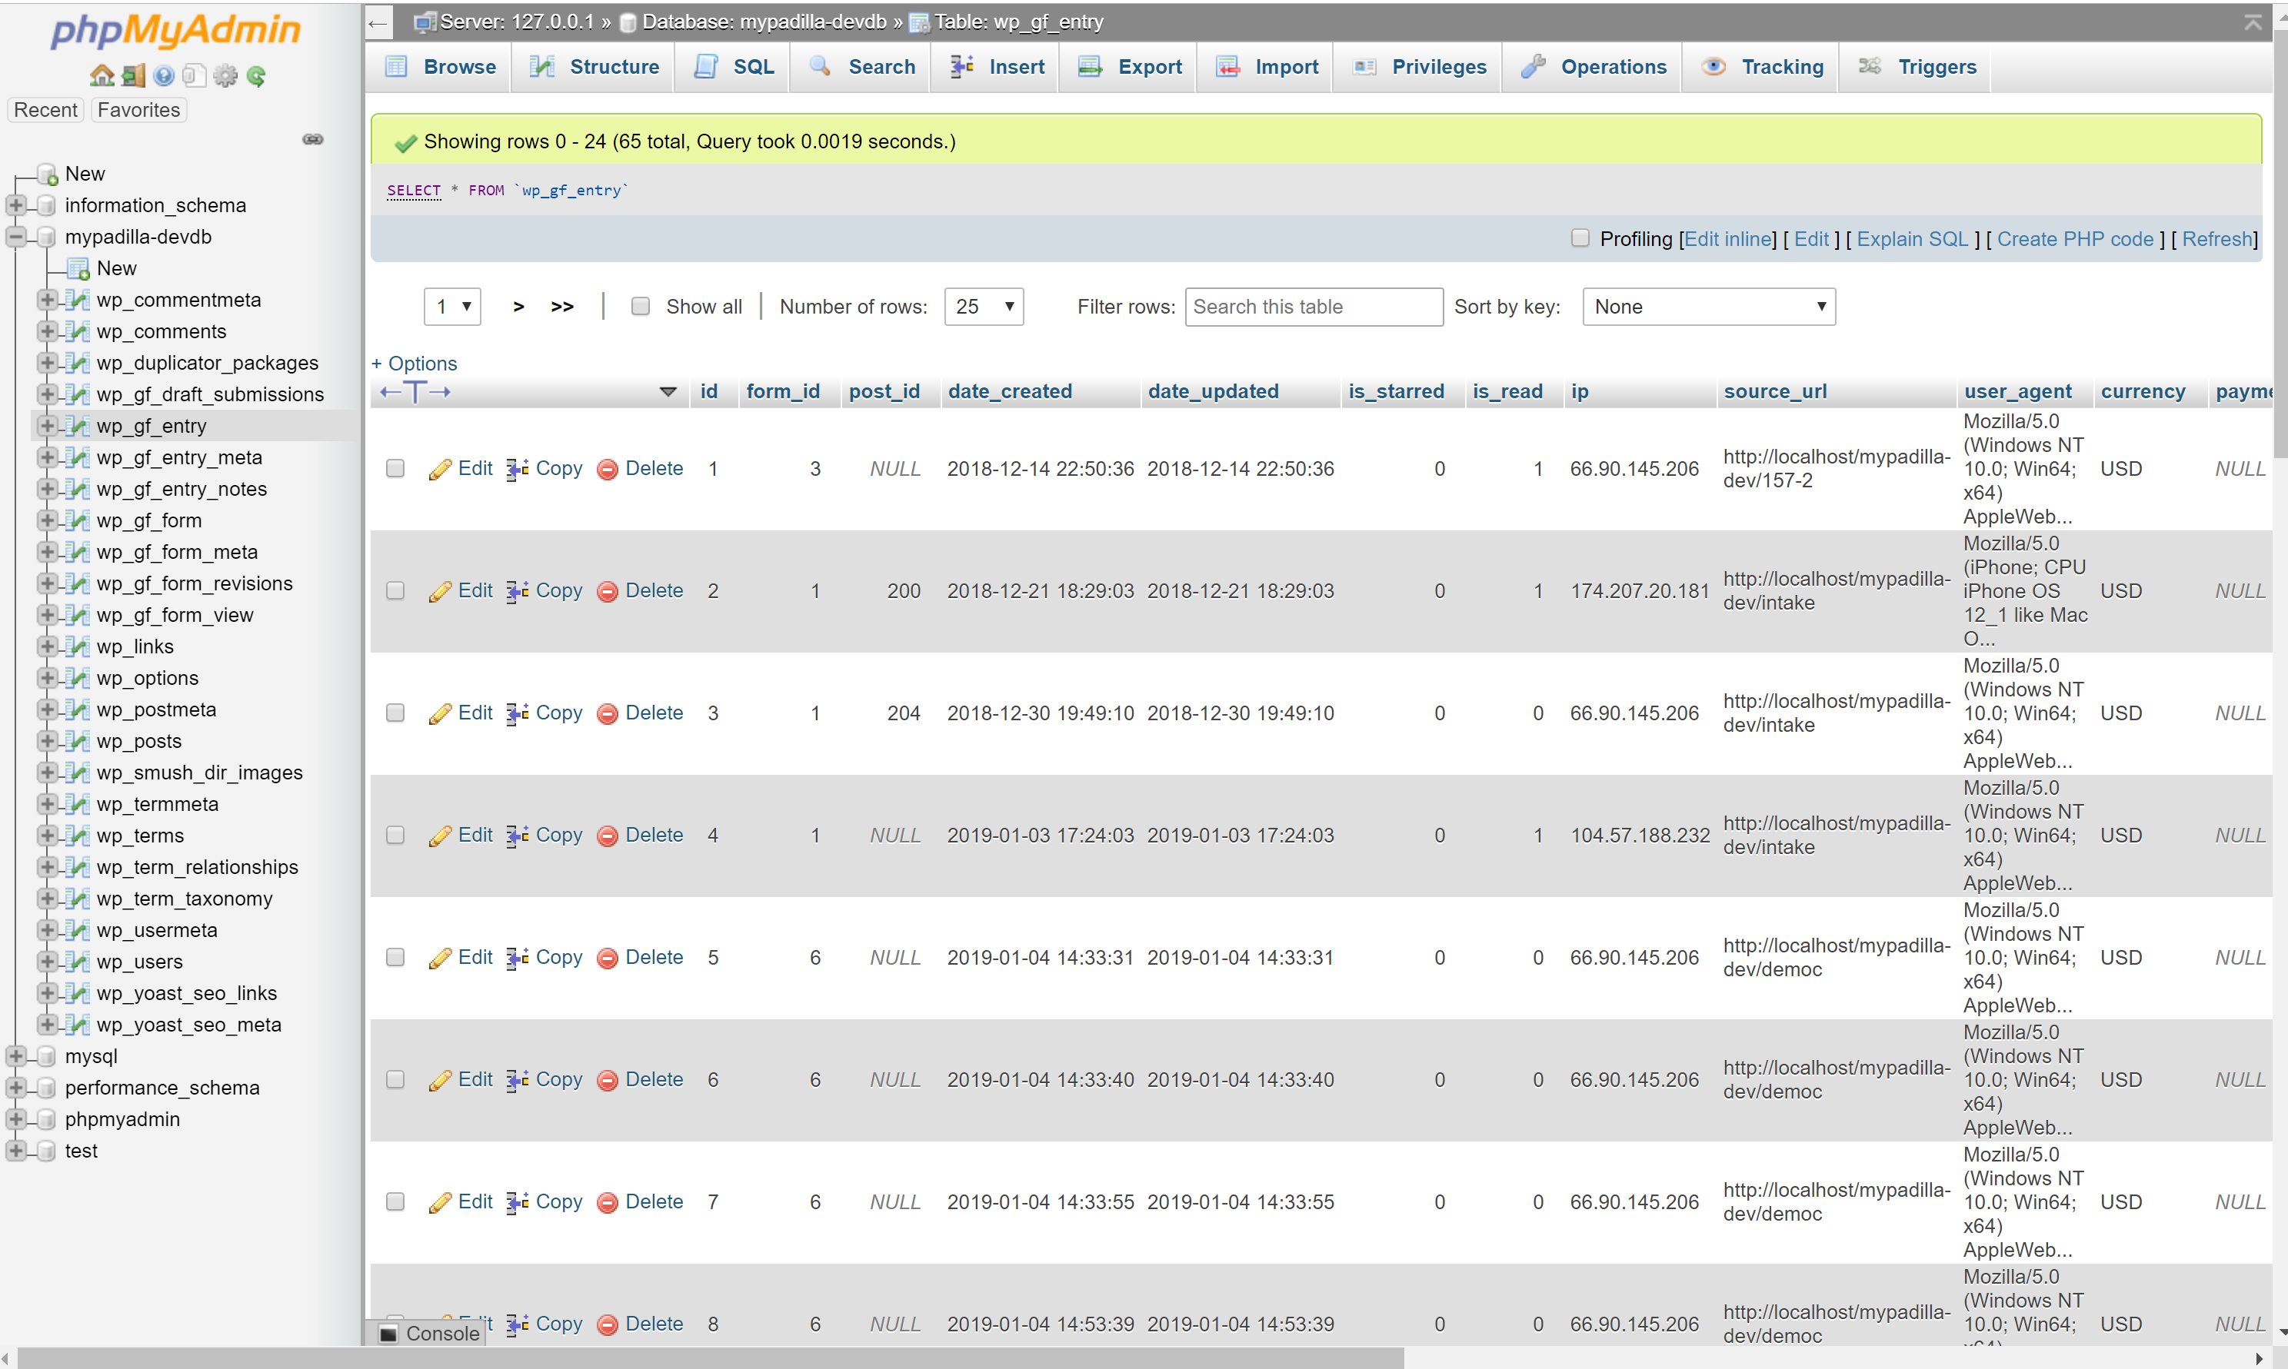
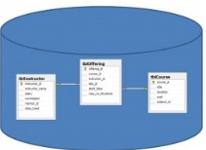
Example: Web application
How web applications work
Web browser on a client sends a request to a web server.
Web server processes the request.
Web server passes any data requests to the database server.
Database server returns results to web server.
Web server returns a response to the browser.

Slide 11
Compute architectures
Dumb Terminal
Presentation Logic
Presentation Layer/Logic
Presentation Layer/Logic
Mainframe
Business Logic Layer
2-tier client Server
Business Logic Layer
N-tier client Server
Business Logic Layer
Data Layer
Data Layer
Data Layer
Centralized
Web Browser
Presentation Logic
In distributed architecture, components are presented on different platforms and several components can cooperate with one another over a communication network in order to achieve a specific objective or goal.
https://www.tutorialspoint.com/
Cloud Computing
Business Logic Layer
From simple to complex to seemingly simple
Reliability, availability, flexibility
Data Layer
Distributed

Slide 12
Review: Relational Databases

Slide 13
Relational database history
Year | Event
1970 | Dr. E. F. Codd (from IBM) developed the relational database model
1979 | Relational Software, Inc. (later renamed Oracle) released the first relational DBMS, Oracle
1982 | IBM released their first relational database system, SQL/DS (SQL/Data System)
1985 | IBM released DB2 (Database 2)
1987 | Microsoft release SQL Server
1989 | The American National Standard Institute (ANSI) published the first set of standards for a database query language, called ANSI/ISO SQL-89 or SQL1. These standards were similar to IBM’s DB2 SQL dialect. Because there were no stringent standards, most commercial products could claim adherence.
1992 | ANSI published ANSI/ISO SQL-92 or SQL2, more stringent than SQL1. Incorporated many new feature. Levels of compliance or conformance to indicate the extent a dialect meets standards.
1995 | My SQL AB released MY SQL for internal use
1999 | ANSI published ANSI/ISO SQL-2003 or SQL4. Support for objects. Levels of compliance or conformance dropped and replaced by core specification + nine packages.
2003 | ANSI published ANSI/ISO SQL-99 or SQL3. Support for XML.
2008, 2010 | Sun Microsystems acquired My SQL. Oracle acquired Sun Microsystems and My SQL.

Slide 14
Comparison of relational databases
 | Oracle | DB2 | SQL Server | MySQL
Release year | 1979 | 1985 | 1987 | 2000
Platforms | Unix OS/390, Z/OS Windows Mac OS | OS/390, Z/OS Unix Windows Mac OS | Windows | Unix Windows Mac OS Z/OS
Other relational databases – PotsgreSQL, Teradata, (Informix, RDB, Sybase, …)

Slide 15



File Systems for the data layer
Redundant data – more difficult to manage
Custom software based on the format of the file to read data, create new records, update existing data, deleting existing data
Performance dependent on custom software
Difficult to share data
Difficult to provide access to multiple applications

Slide 16


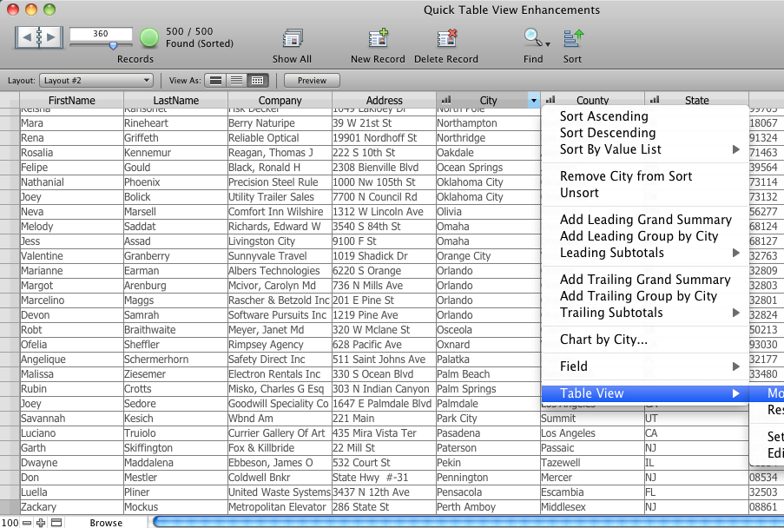
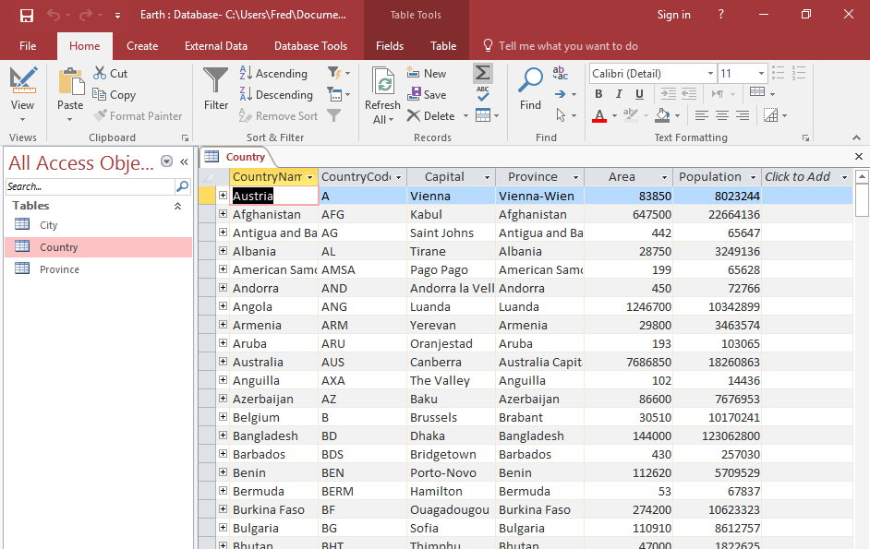
Local databases
Overcomes redundancy & maintenance issues of file-based data layer
Installed on client computer typically (makes sharing hard)
Apple’s FileMaker Pro
Microsoft Access

Slide 17
Database management systems
A relational database management system (DBMS) is software to manage the data layer in enterprise applications
Main purpose is storage and retrieval of data without knowledge of the physical organization of data
Other features include efficiency, data integrity, security, ability to scale to large data volumes and large number of concurrent users
A DBMS needs to be ACID compliant
A – Atomic
C – Consistent
I – Isolation
D – Durability

Slide 18
ACID
To have optimal transaction control, a database system must be ACID compliant, which stands for the following properties: Atomicity, Consistency, Isolation, Durability. The definitions of the ACID properties are:
Atomicity: A transaction must be completed in its entirety or not at all. If a transaction aborts in the middle, all operations up to that point must be completely nullified.
Consistency: A transaction must transform a database from one consistent state to another consistent state. In other words, all data in a database must work as a state machine. The database must ensure all data is consistent at all times with all rules.
Isolation: Each transaction must occur independently of other transactions occurring at the same time. In other words, queries and transactions always run at a point in time. You can query data while many other users are changing data and you will not see their changes, and they will not see each other’s changes.
Durability: Committed transactions must be fully recoverable in all but the most extreme circumstances. Write-ahead logs provide absolute data durability until data is eventually written into permanent data and index files.
The ACID properties are intended to guarantee valid database transactions, even if there are network errors, disruptions, hardware failures, etc. For this reason, ACID-compliant databases are important for organizations in many different types of industries, especially those who conduct monetary transactions, handle time-sensitive data, or manage/monitor data in manufacturing, transportation or energy production. ACID compliance can also play an important role in data management in mission-critical operations in IoT environments
https://www.faircom.com/

Slide 19
Database approach
CRM maintains Customer data
Central database
Contains employee,
customer, product,
inventory, order
data
Product Master maintains product details
DBMS
Inventory Management
Data is managed by a controlling agent
Central repository of shared data so all agents can access data they need
Data stored in a standardized, convenient form
Database Management System (DBMS) manages and governs

Slide 20
Database and data terms
Database
Table
Row
Column
Cell
Primary key
Composite primary key
Non-primary key (unique key)
Index
Foreign key
Data
Data type
Null value
Default value

Slide 21
Data Modeling
Before creating a database we create a data “model”
To create a data model we need to identify all the data that are required
What data elements are required in creating a data model for Chase Bank?
What data elements are required in creating a data model for Netflix?
What data elements are required in creating a data model for Kaiser Permanente?

Slide 22
Relational Data Modeling

Slide 23
What is a model?
A model is a ”representation” of the real-world

Slide 24
Designing the data model
Conceptual Model
Logical Model
Physical Model
Non-technical English language statements developed collaboratively that articulate the role of data in the business
Conceptual model translated into entities and relationships using Entity-Relationship modeling tools
Conversion of logical data model into definitions of tables and columns (database).

Slide 25
Conceptual model
Top-down Start with strategic conversations with stakeholders to articulate the conceptual model in simple easy to understand English language statements.
Bottom-up Start with artifacts, documents and systems analysis to articulate the conceptual model in simple easy to understand English language statements.
Both approaches should lead to the same place
Comparing top down and bottom up approaches: ISEDJv11n1p14.pdf

Slide 26
Conceptual model – top-down
Accounts payable example
Top-down conversation
We will receive invoices from several vendors.
Each vendors will have a different format for their invoice.
The invoice will include a vendor invoice number and a corresponding purchase order number issued by us.
Vendors will include their contact information on the invoices as well as their payment terms and the contract corresponding to those terms.
Invoices will include a total amount owed as well as line items of products and services that make up the total.

Slide 27
Conceptual model – bottom-up
Accounts payable example
Bottom-up artifact
Typically, more useful in changes, rather than in starting off. Often, a mixture of top down and bottoms up is used in a real DB design

Slide 28
Conceptual model – top-down
In the discussion session at the end of the class, use these examples to think about what type of conversations would take place
Chase Bank example
Top-down conversation
…
Netflix example
Top-down conversation
…

Slide 29
Designing the data model
Conceptual Model
Logical Model
Physical Model
English language statements developed collaboratively that articulate the role of data in the business
Conceptual model translated into entities and relationships using Entity-Relationship modeling tools
Conversion of logical data model into definitions of tables and columns (database).

Slide 30
Logical model six-step process
Step 1: Identify the data elements (entities and attributes)
Step 2: Subdivide each element into its smallest useful components
Step 3: Define the entities (tables) and attributes (columns)
Step 4: Identify and define relationships between the entities and translated these to primary and foreign keys
Step 5: Review whether the data structure is normalized
Step 6: Identify the indexes

Slide 31
Let’s start building a model together
Scenario
Students and courses
Students have a student Id, full name, date of birth, and address
Courses have a course id, and a name
A student can register for multiple courses

Slide 32
Let’s start building a model together
Students and courses
Students have a student Id, full name, date of birth, and address
Courses have a course id and name
A student can register for multiple courses
Step 1: Entities and attributes
Student – studentid, fullname, dob, address
Course – coursed, name
Registration

Slide 33
Let’s start building a model together
Students and courses
Students have a student Id, full name, date of birth, and address
Courses have a course id and name
A student can register for multiple courses
Step 2: Subdivide
Fullname – firstname, middleinitial, lastname
Address – number, streetname, city, state, zip
…
…

Slide 34
Let’s start building a model together
Students and courses
Students have a student Id, full name, date of birth, and address
Courses have a course id and name
A student can register for multiple courses
Step 3: Define
entities (tables)
attributes (columns)
…

Slide 35
Let’s start building a model together
Students and courses
Students have a student Id, full name, date of birth, and address
Courses have a course id and name
A student can register for multiple courses
Step 4: Relationships
Primary Keys
Foreign Keys
…

Slide 36
Student
Course
StudentId(PK)
CourseId(PK)
Registration
Can have
Can have
RegistrationId(PK)
CourseId(FK)
StudentId(FK)

Slide 37
Accounts payable system model
Scenario
We will receive invoices from several vendors.
Each vendors will have a different format for their invoice.
The invoice will include a vendor invoice number and a corresponding purchase order number issued by us.
Vendors will include their contact information on the invoices as well as their payment terms and the contract corresponding to those terms.
Invoices will include a total amount owed as well as line items of products and services that make up the total.

Slide 38
Step 1: Identify the data elements
Vendor name
Vendor address
Vendor phone number
Vendor fax number
Vendor web address
Vendor sales contact name
Vendor sales contact ext
Vendor AR contact name
Vendor AR contact ext
Invoice number
Invoice date
Invoice terms
Invoice total
Item part number
Item quantity
Item description
Item unit price
Item extension
Vendor
Invoice
Item

Slide 39
Step 2: Subdivide data elements
Vendor name
Vendor address
Vendor phone number
Vendor fax number
Vendor web address
Vendor sales contact name
Vendor sales contact ext
Vendor AR contact name
Vendor AR contact ext
Invoice number
Invoice date
Invoice terms
Invoice total
Item part number
Item quantity
Item description
Item unit price
Item extension
Which data elements are candidates for sub-dividing?

Slide 40

Step 2: Subdivide data elements
How about Vendor Sales Contact Name?

Slide 41
Step 2: Subdivide data elements
How about Vendor Address?

Slide 42
Step 3: Define the entities and attributes
Vendor name
Vendor address
Vendor phone number
Vendor fax number
Vendor web address
Vendor sales contact name
Vendor sales contact ext
Vendor AR contact name
Vendor AR contact ext
Invoice number
Invoice date
Invoice terms
Invoice total
Item part number
Item quantity
Item description
Item unit price
Item extension

Slide 43
Step 4: Identify the Primary and Foreign Keys
VendorId (PK)
VendorName
VendorAddressStreetAndNumber
VendorAddressCity
VendorAddressState
VendorAddressZip
VendorPhoneNumber
VendorFaxNumber
VendorWebAddress
VendorSalesContactFirstName
VendorSalesContactastName
VendorSalesContactExt
VendorARContactFirstName
VendorARContactLastName
VendorARContactExt
Vendor
InvoiceId(PK)
VendorId(FK)
InvoiceNumber
InvoiceDate
InvoiceTerms
InvoiceTotal
Invoice
Item part number
ItemLineNumber(PK)
InvoiceId(FK)
ItemQuantity
ItemDescription
ItemUnitPrice
ItemExtension
Item
1
issues
N
1
Includes
N

Slide 44
Breakout Team Exercise

Slide 45
In-Class Exercise – Data Design
Random break-out teams of 4-10 people each
In your teams discuss how would you start modeling the data for a problem of your choice
You will have 8 minutes to complete this exercise and then you will share your work

Slide 46
Presentations? If we have time…
One representative
What is the database you are designing
What is one interesting question you want to be able to answer
How is your database designed
Any interesting thoughts?

Slide 47

Next class
Review of advanced relational database modeling concepts such as normalization and data integrity + beginning of SQL
Read articles and review video(s) that will be posted on Canvas
Come prepared to discuss and work in teams

Slide 48
What question may I answer before we end …?
Remember, all questions are good questions!

